Slide 1
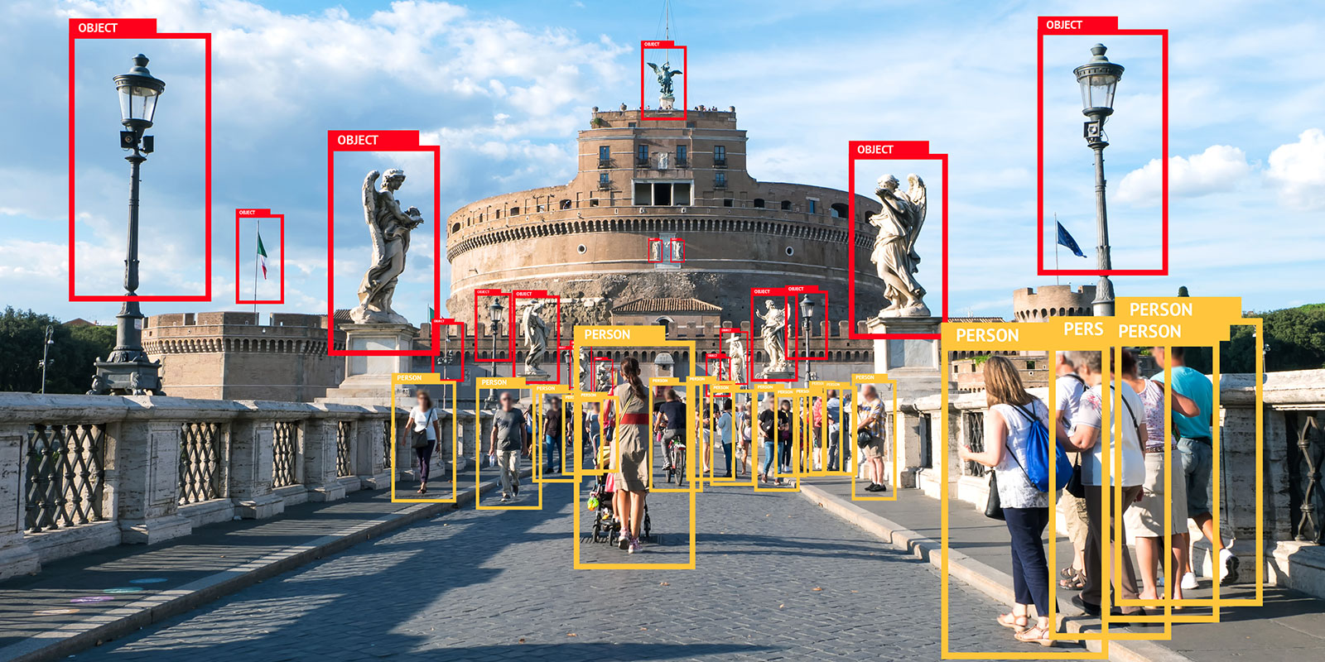
Security Object Detection ~ Surveillance
Cynthia Milan, Manuel Rodriguez, and Edgar Gallegos
School of Computer Science and Engineering, CSUSB
CSE 5350 - Prof. Q. Sun
Fall 2020

Slide 2

Topic
What is Computer Vision and Network ?
Common used tool known as image and video recognition
Commonly used to identify objects, faces, and a variety of other things
Identified in a single or few frames
Mainly through connected layers
Each with different dimensions
What is our study?
A Security Object Detector
Surveillance

Slide 3

Introduction
Why a security object detection as surveillance?
Asset to many lives
Solution to many security problems using technology
Implementation of security features in place of comfort
Great benefit to companies, businesses, and residency
Surveillance
businesses/ companies
Avoid inappropriate visits
Avoid inappropriate behaviors

Slide 4
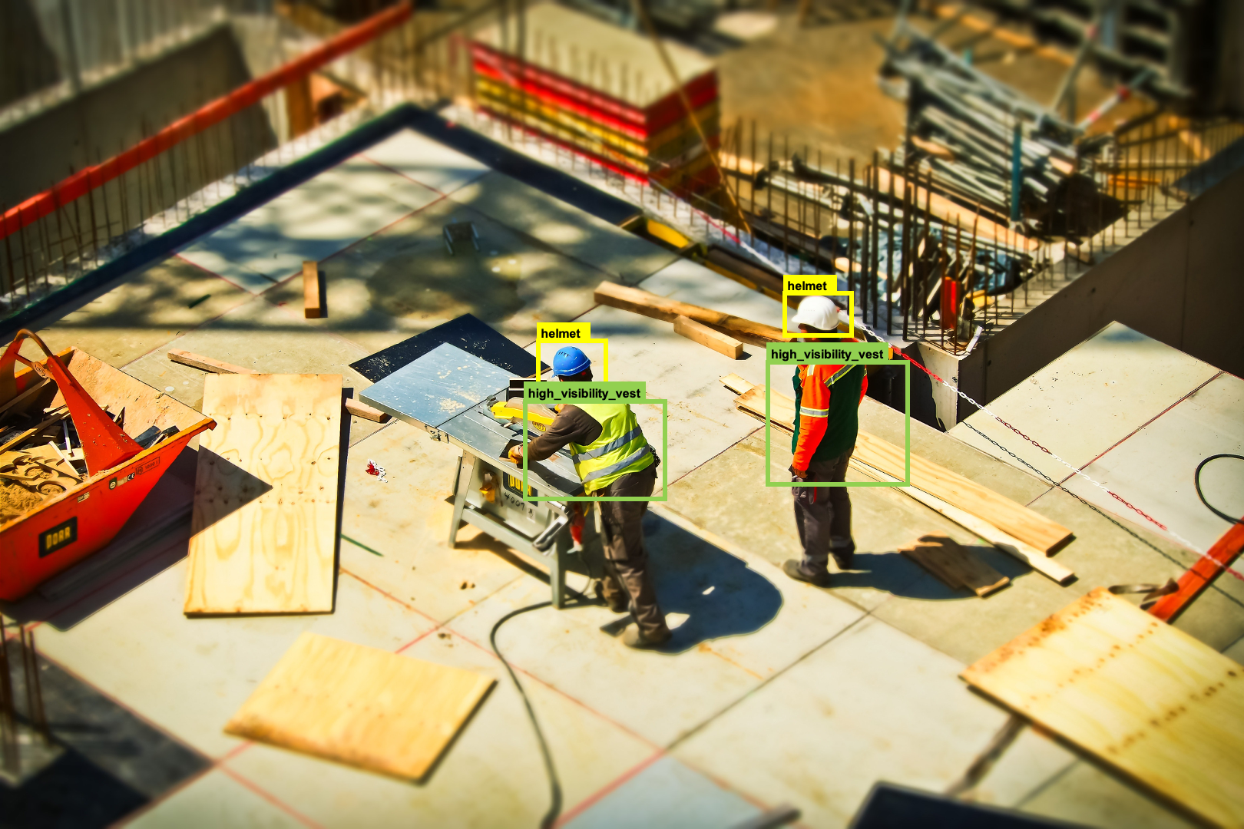
Related Work
Construction
Wuhan, China
Used Convolutional Neural Network
record / detect activities of construction workers
Goal?
Observation
Ensure projects and jobs are done:
Accordingly
On time
Well organized

Slide 5

Computer Vision
What is it?
2 and 3 dimensional figures with a variety of dynamics
Figures analysed with multiple layers of frames
Each with different dimensions
All connected for data analysation

Slide 6
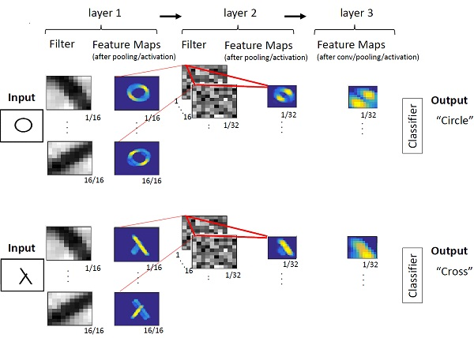
Similar Work
Leigh Johnson
Google Developer Expert
“Real-time Object Tracking with TensorFlow, Raspberry Pi, and Pan-Tilt HAT”
Raspberry Pi
Tensor Lite
MobileNetV3-SSD
PID Controller
Proportional integral derivative (PID)
Coral’s USB Ege TPU Compiler

Slide 7
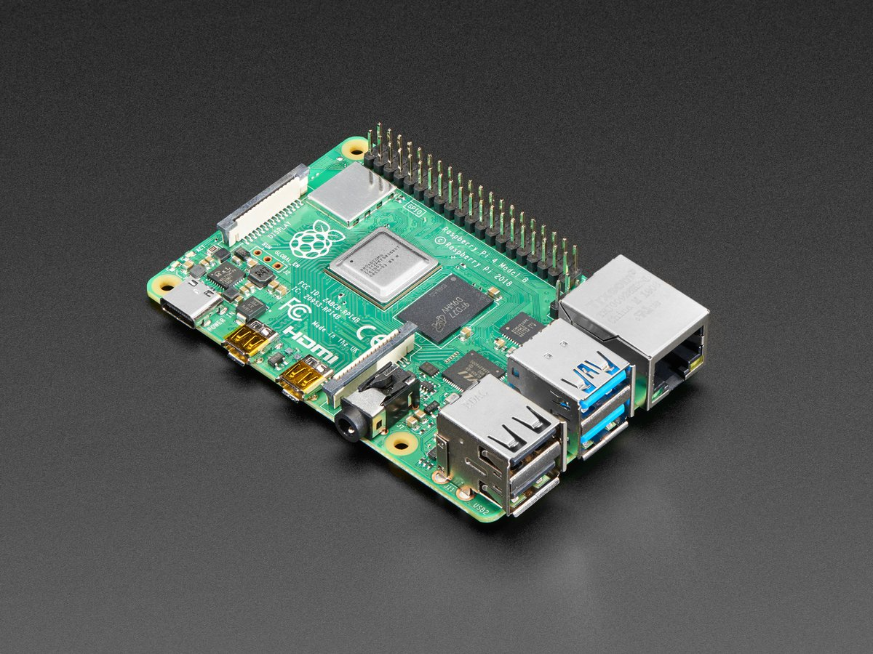
Method
Raspberry Pi
Easier to work with
Affordable
Works with Python and Linux
TensorFlow Lite
COCO
MobileNetV1

Slide 8
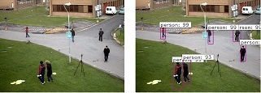
Experiment
The algorithm is able to detect people
The testing was done indoor with optimal lighting conditions
Algorithm can detect more than just one person

Slide 9
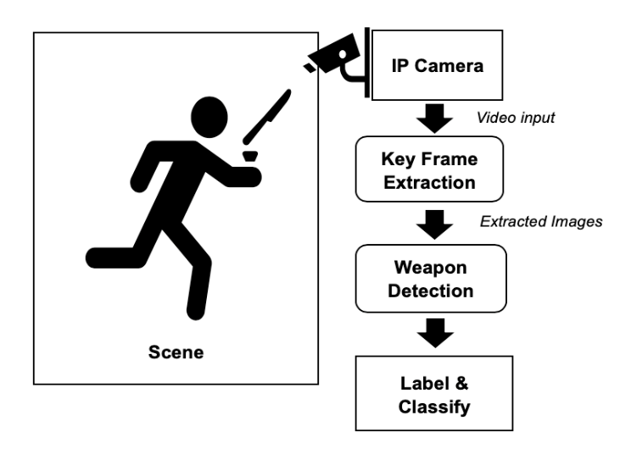
Convolutional Neural Networks
We used human detection by implementing Convolutional Neural Network (CNN) since is the most widely used deep learning technology, and it performs very well in the fields of image classification and object detection
It can also be used to detect potentially dangerous intruders equipped with firearms. The figure to the right shows the functional blocks of the proposed system. After the video is captured by the surveillance camera, it is passed to the key frame extraction subsystem, which reduces data size by selecting key frames for feasible real time running of the subsequent steps

Slide 10
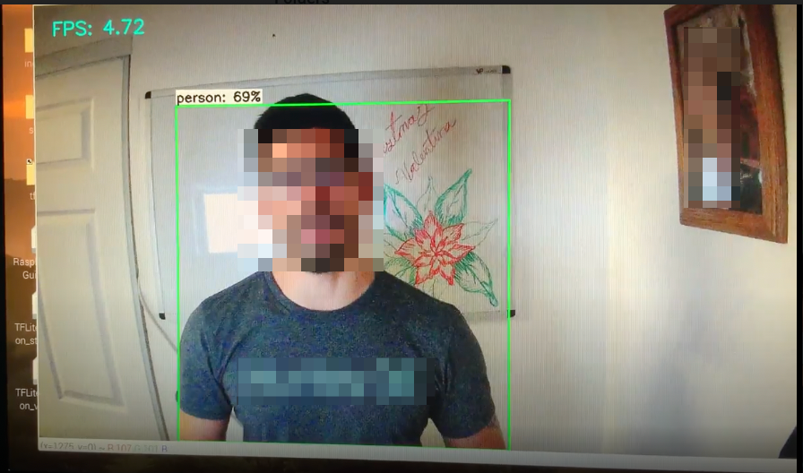
Results
Overall, we were successful in creating an algorithm that detects humans using existing COCO datasets and Tensorflow Lite to accomplish our goal.
The algorithm can be modified and improved upon to increase its functionality and efficiency.
The algorithm is able to detect humans with 70% accuracy or better. Combined with different hardware, it has the potential of replacing different equipment in addition in aiding in home surveillance. We have also demonstrated how CNN can be used to detect other objects, not just humans

Slide 11
Q/A

